Slide 1
Greibach Normal Form
Definition
A context free language is said to be in the Greibach normal form if all productions are of the form
A→ aα where a ∈ T and α ∈ V*.

Slide 2
Greibach Normal Form
Lemma1 (Substitution rule)
Let G = {V, T, P, S} be a CFG.
Let A → Bα be a production in P if there is a production B → β1 | β2 | β3 | β4 ……….
Then the equivalent grammar can be obtained by substituting B in A.
The resulting grammar is A → β1 α | β2 α | β3 α | β4 α

Slide 3
Greibach Normal Form
Lemma 2 (Elimination of left recursion)
We can generalize this grammar. For any CFG given as A → A α1 | A α2 | A α3 ….. | β1 | β2 | β3 | …… the equivalent grammar after eliminating left recursion is
A → β1 A′| β2 A′| β3 A′| ……| β1 | β2 | β3 | ……
A′ → α1 A′| α2 A′| α3 A′|….. | α1 | α2 | α3 …

Slide 4
Greibach Normal Form
Procedure to Convert the given Grammar to GNF
Eliminate null productions and unit productions, and construct CNF.
2. Rename variables as A₁ A₂ ….. starting with S as A₁
3. For each production of the form A_{i} → A_{j} α, apply the following:
a) if j > i --- leave the productions as they are
b) if j = i --- apply Lemma 2
c) if j < i --- apply Lemma 1

Slide 5
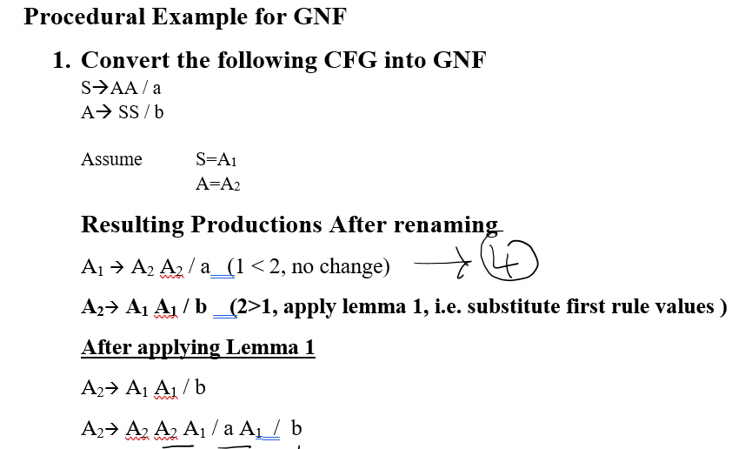
Example

Slide 6
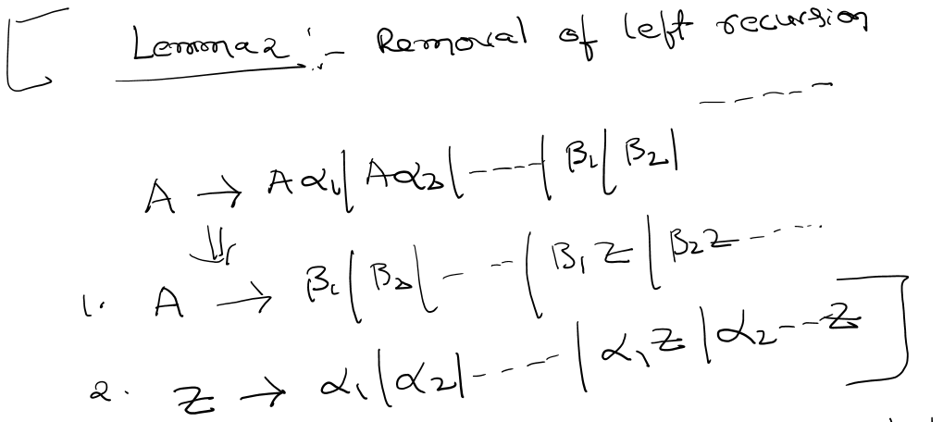
Example

Slide 7
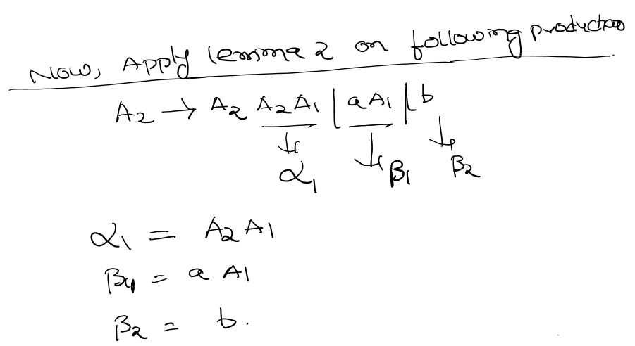
Example

Slide 8
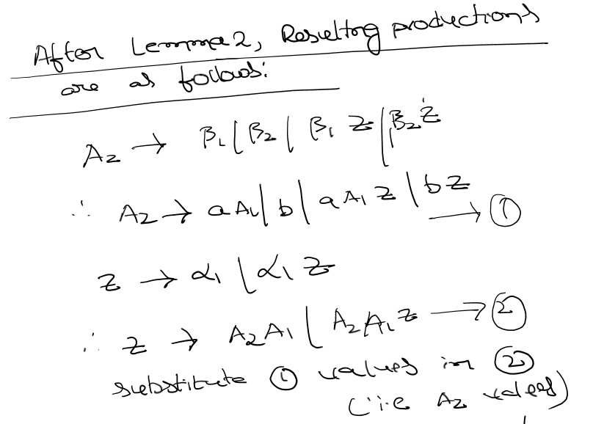
Example

Slide 9
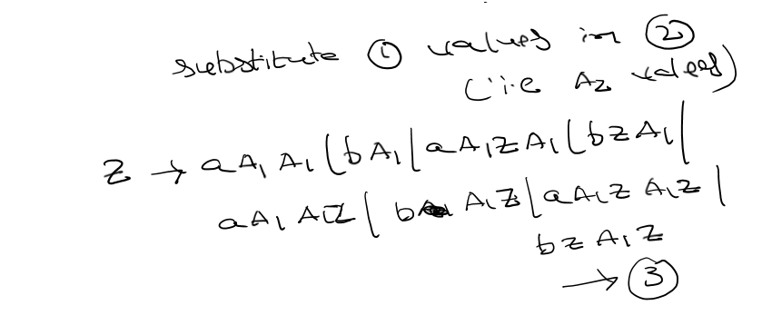
Example

Slide 10
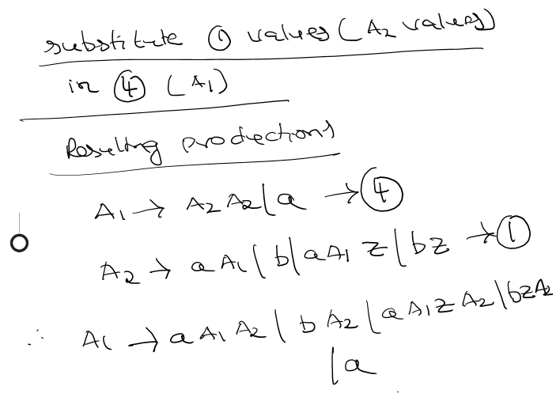
Example

Slide 11
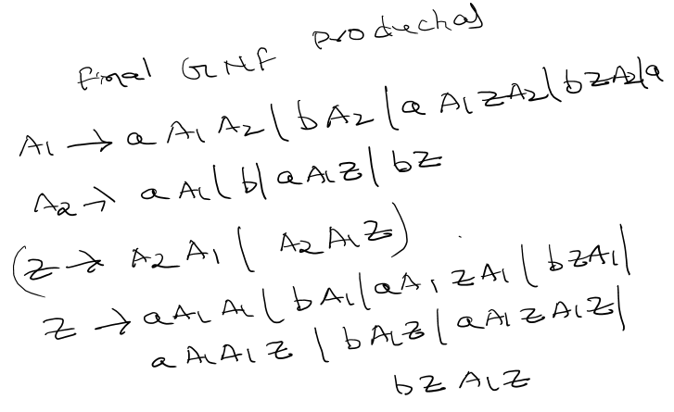
Example

Slide 12
Example

Slide 13
Pumping Lemma for CFL(Context Free Language)
Pumping Lemma for Context-free Languages (CFL) Pumping Lemma for CFL states that for any Context Free Language L, it is possible to find two substrings that can be ‘pumped’ any number of times and still be in the same language. For any language L, we break its strings into five parts and pump second and fourth substring.
Pumping Lemma, here also, is used as a tool to prove that a language is not CFL. Because, if any one string does not satisfy its conditions, then the language is not CFL.
Thus, if L is a CFL, there exists an integer n, such that for all w ∈ L with |w| ≥ n, there exists u, v, x, y, z ∈ Σ∗, such that x = uvwxy, and
(1) |vxy| ≤ n (2) |vy| ≥ 1 (3) for all i ≥ 0: uv^{i}wx^{i}y ∈ L

Slide 14
Pumping Lemma for CFL- Example
{0^{n}1^{n}2^{n} | n ≥ 0} is not Context-free.
Step 1:
w= 0^{n}1^{n}2^{n} and |w|=3n > n, Thus apply CFL-pumping lemma principle in step 2
Step 2:
Divide w into five substrings, say, u, v, w, x, and y such as |vwx|<=n and |vx|>0
Step 3:
Let for all i ≥ 0: uv^{i}wx^{i}y ∈ L
0000....000 1111.....111 2222..22222
Assume v = 0^{k} , w = 0^{m} , x = 0^{p} , Here |vwx|<=n and |vx| >0.
At i=0
uv⁰wx⁰y= uwy=0^{n-m-k-l} 1^{n} 2^{n} , in which n-m-k-p is not equal to n. i.e.,
0^{n-m-k-l} 1^{n} 2^{n} does not belongs to L. Thus, 0^{n}1^{n}2^{n} | n ≥ 0} is not Context-free.

Slide 15
Pumping Lemma for CFL- Example
{ww^{R}w| w є {0,1}} is not Context-free.
Step 1:
??
Step 2:
??
Step 3:
?
?

Slide 16
Pumping Lemma for CFL- Example
L = {w w | w is a bitstring}. Show that L is not a context free
Step 1:
??
Step 2:
??
Step 3:
?
?

Slide 17
Closure Properties of CFL
Closure Properties of CFLs
CFLs are closed under union
CFLs are closed under concatenation
CFLs are closed under closure
CFLs are not closed under intersection
CFLs are not closed under complement

Slide 18
Push Down Automata (PDA)
The concept Push Down Automata (PDAs) is useful in designing parsers or syntax analysers. A parser verifies the syntax of the text. Parsing is a part of the compilation process. So, knowledge of PDAs is useful in compiler design

Slide 19
Push Down Automata (PDA)
PDA consists of three components:
An input tape
“The input tape consists of a linear configuration of cells each of which contains a character from the input alphabet”
2) a finite control
The control unit has some pointer (head) which points the current symbol that is to be read. The head positioned over the current stack element can read and write special stack characters from that position
a stack structure.
The stack is also a sequential structure that has a first element and grows in either direction from the other end

Slide 20
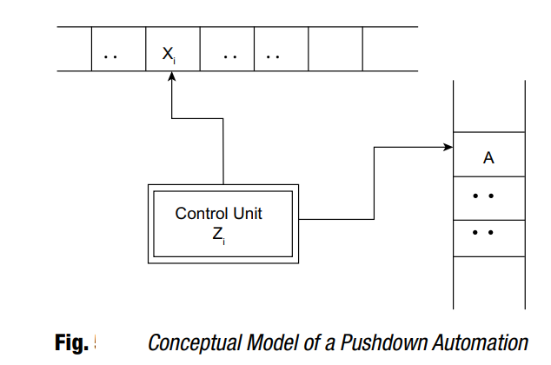
Push Down Automata (PDA)

Slide 21
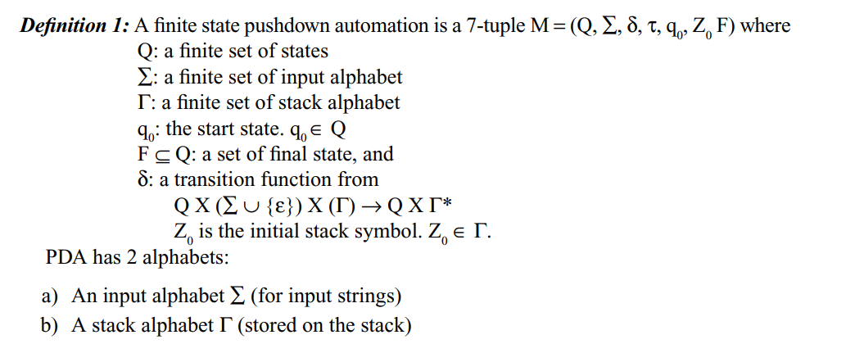
Push Down Automata (PDA)

Slide 22
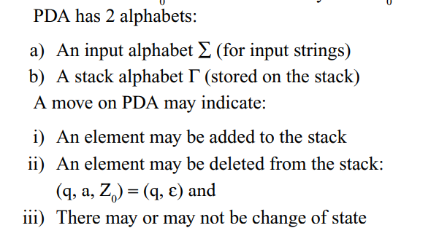
Push Down Automata (PDA)

Slide 23
Push Down Automata (PDA)

Slide 24
Instantaneous Description of PDA
Instantaneous Description (ID) is an informal notation of how a PDA “computes” a input string and make a decision that string is accepted or rejected.
A ID is a triple (q, w, α), where: 1. q is the current state. 2. w is the remaining input. 3.α is the stack contents, top at the left.

Slide 25
Language Accepted by PDA
A language can be accepted by a PDA using two approaches:
1. Acceptance by final state:
The PDA accepts its input by consuming it and finally it enters the final state.
2. Acceptance by empty stack:
On reading the input string from the initial configuration for some PDA, the stack of PDA becomes empty

Slide 26
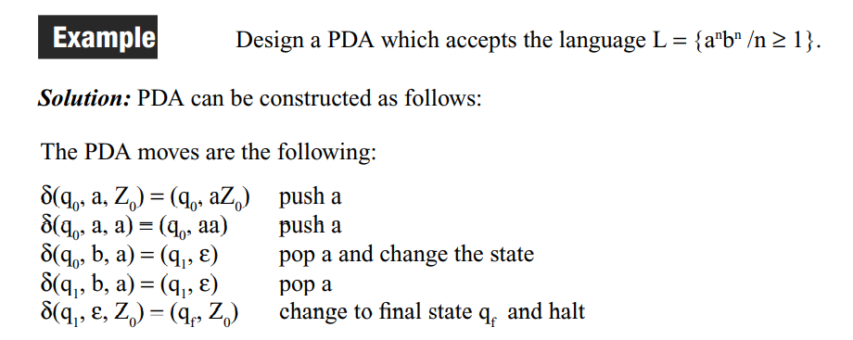
Example of PDA

Slide 27
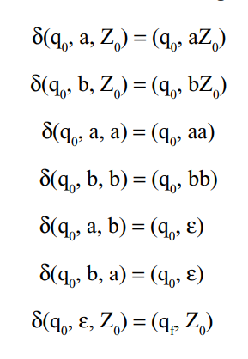
Example of PDA

Slide 28
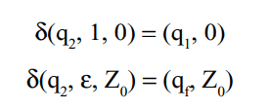
Example of PDA

Slide 29
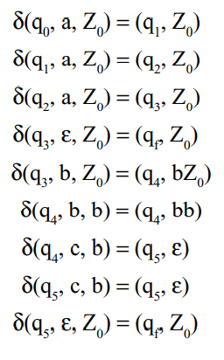
Example of PDA

Slide 30
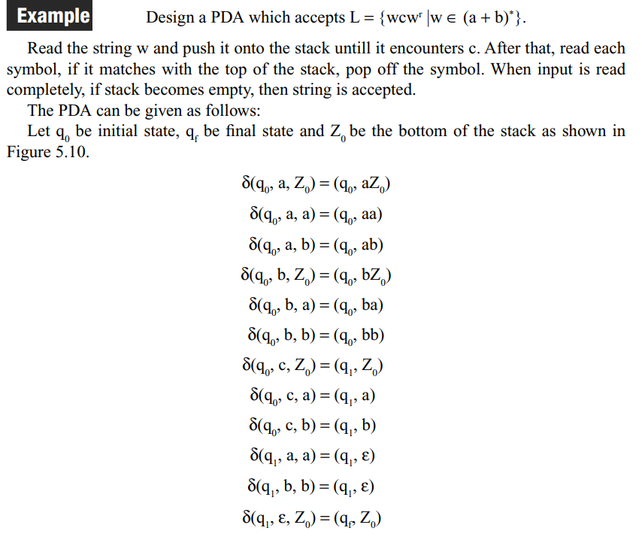
Example of PDA

Slide 31
Parse Tree or Derivation Tree Construction
Derivation tree is a graphical representation for the derivation of the given production rules for a given CFG.
It is the simple way to show how the derivation can be done to obtain some string from a given set of production rules. The derivation tree is also called a parse tree.

Slide 32
Ambiguous Grammars
A CFG is said to ambiguous if there exists more than one derivation tree for the given input string
i.e., more than one Left Most Derivation Tree (LMDT) or Right Most Derivation Tree (RMDT)

Slide 33
Ambiguous Grammars: Example
More than LMDs for the string id+id*id , Thus this Grammar is Ambiguous

Slide 34
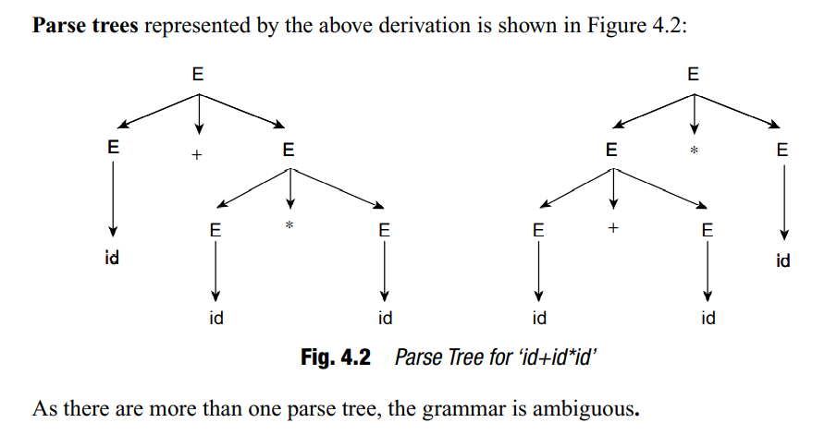
Ambiguous Grammars: Example
More than one parse trees for the string id+id*id , Thus this Grammar is Ambiguous

Slide 35
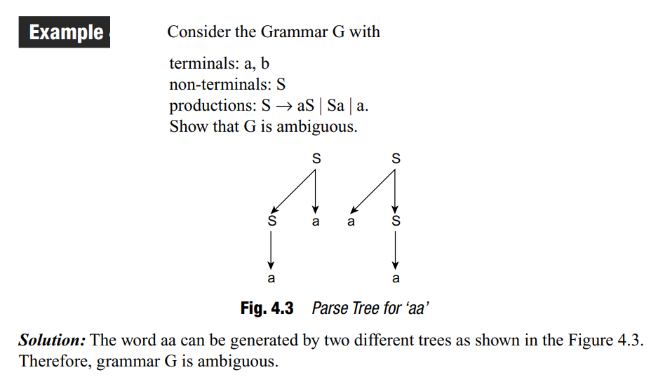
Ambiguous Grammars: Example
More than one parse trees for the string aa, Thus this Grammar is Ambiguous

Slide 36
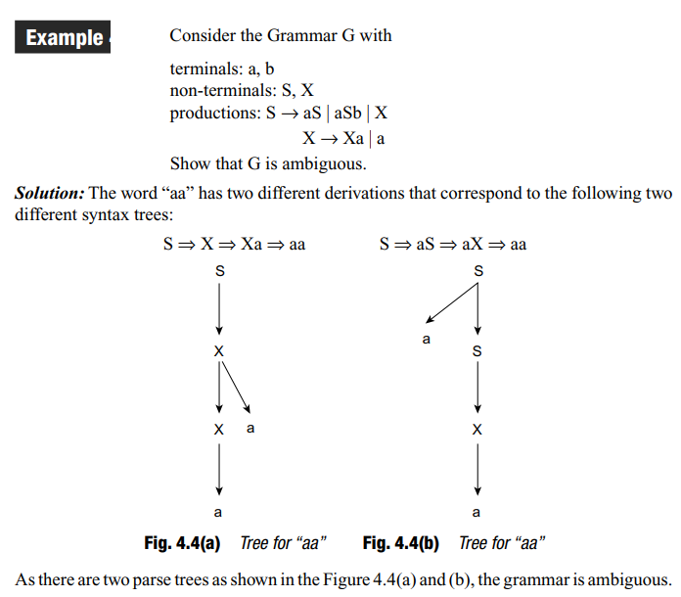
Ambiguous Grammars: Example
More than one parse trees for the string aa, Thus this Grammar is Ambiguous

Slide 37
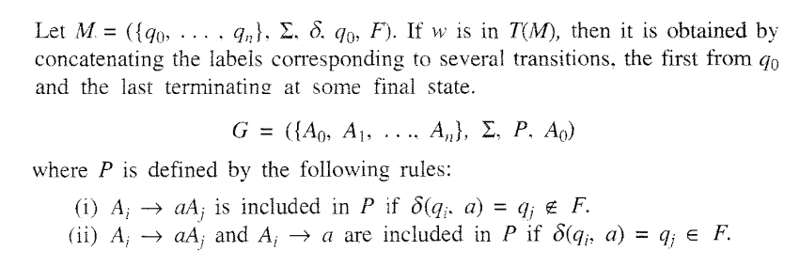
Construction of Regular Grammar T(M) Generating for a Given DFA

Slide 38
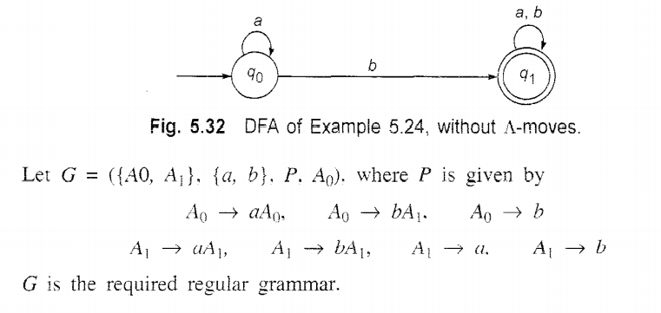
Construction of Regular Grammar T(M) Generating for a Given DFA: Example

Slide 39
Constructing a FA (Finite Automata) for given Regular Grammar (RG)
Finite Automata M = ({q0,q1,qf}, {a,b},δ, qo, {qf})

